Slide 1


CDS 590
Final Presentation
Predicting Real Private Consumption
Using Time Series:
A Machine Learning Approach
Supervisor : Mohd Azam Osman
Student Name : Muhammad Azzubair bin Azeman
Mentor : Patrick Lam Kar Jun
Practicum Company : DataMicron Systems Sdn Bhd

Slide 2


Background of Company
DataMicron Systems Sdn Bhd is a consultant services company which offers big data solutions and consultation services in data analytics.
My role in this company is to assist in providing prediction of a time series using machine learning algorithm for their Proof of Concept with Ministry of Finance (MoF).
Therefore, this consultancy project will benefit DataMicron in providing proposed efficient solution for MoF.

Slide 3
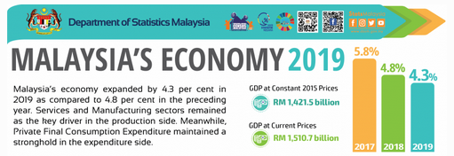
Background of Domain
1. What is Real Private Consumption (RPC)?
The amount of goods and services consumed by households to fulfill their basic needs and wants (DoSM, 2020)
2. Why is it important to predict RPC?
RPC is the major contributor (58.7% in 2019) to Malaysia’s GDP (Asada et al., 2019).
Where :
GDP = Gross Domestic Product
C = Private Consumption
G = Government Consumption
I = Investment
NX = Net Export (Import - Export)
3. What is the relation of RPC with GDP?
RPC is one of the indicator of GDP :
GDP = C + G + I + NX

Slide 4
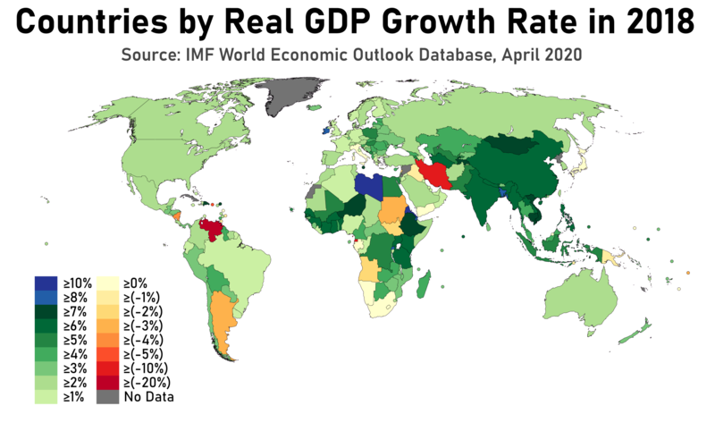
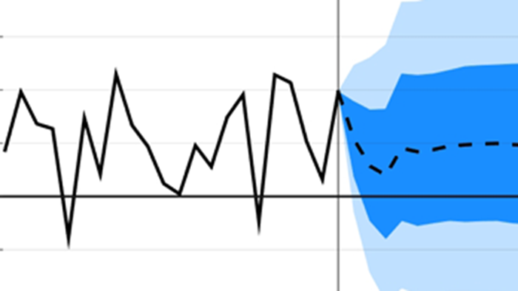
Background of Domain
4. What is Gross Domestic Product?
“Market value of all final goods and services produced in economy annually” (Hashim et al., 2018)
5. Why it is important to be concern on GDP?
GDP determines economic advancement of a country. It distinguishes economic status of one country to another.
6. How RPC is currently predicted by Government?
Mixed frequency vector auto regression (MFVAR)
Mixed data sampling (MIDAS)
Unrestricted error correction model (UECM)

Slide 5

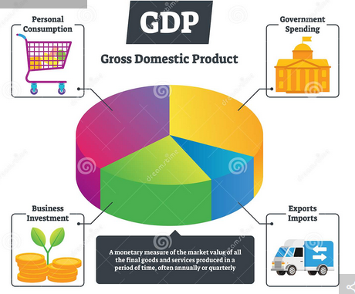
Problem Statement
Much studies have been done on comparing between performances of machine learning models with statistical models especially in economics (Yu, 1999; Dematos et. al, 1996; Kumar, 2018).
However, there is no specific study have been done to compare model performances between machine learning algorithms with statistical techniques for time series prediction of real private consumption in Malaysia.
This study will contribute to the understanding of ML approach for time series prediction of real private consumption specifically and macroeconomics generally.

Slide 6
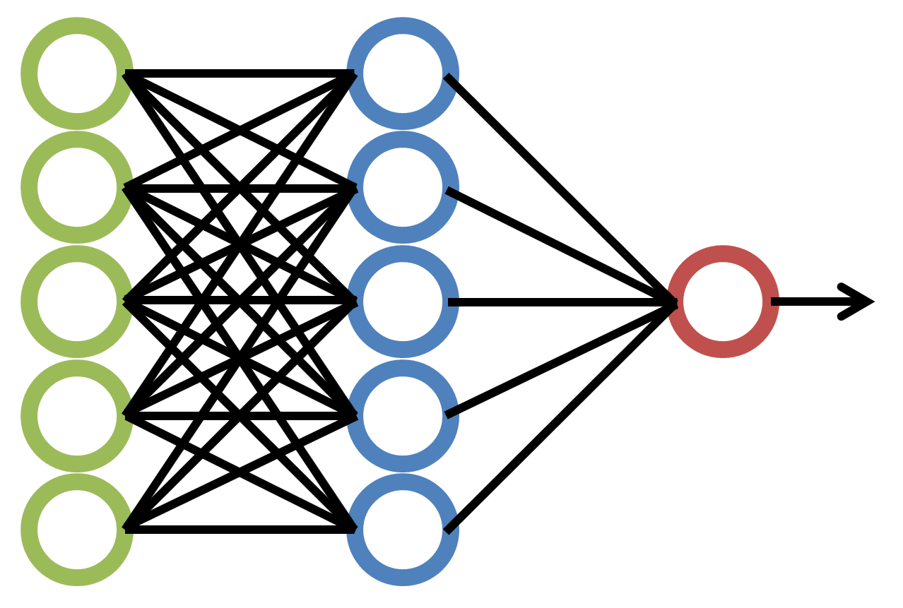

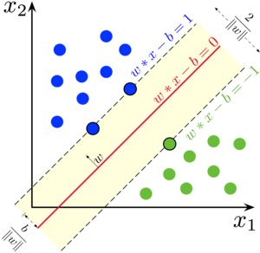




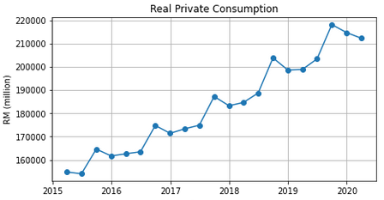
Research Question
Throughout this project, the research questions are as following :
Which machine learning algorithm is the most suitable for RPC prediction?
Among selected machine learning algorithm, which algorithm is better for prediction of real private consumption?
Between statistical and machine learning approaches, which of them is better in model performance evaluation?
RPC (Q1 2020)
→ RM 212257 mil.
RPC (Q2 2020)
→ ?

Slide 7
Objectives
Following the research questions, the objectives are as following :
To investigate the suitable machine learning technique for RPC prediction
To develop RPC prediction model using the selected machine learning algorithms.
To evaluate the performance of RPC prediction models
RPC (Q1 2020)
→ RM 212257 mil.
RPC (Q2 2020)
→ ?

Slide 8
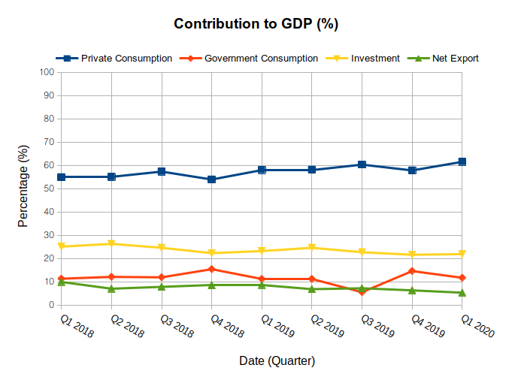
Problem Domain
According Ministry of Finance (2019), contribution to GDP is dominantly contributed by Real Private Consumption since 2018.
Moreover, RPC’s contribution to GDP is quarterly increasing since 2018 (MoF, 2019).
This shows that Malaysia’s GDP is significantly dependent on RPC.
Source: Ministry of Finance (2020)

Slide 9
DSA Techniques
Review
Comparison between Statistical techniques with Machine Learning algorithms
Comparison among Machine Learning algorithms
Yu (1999)
Chen et al. (2019)
Kumar et al. (2018)
Maehashi & Shintani (2020)

Slide 10
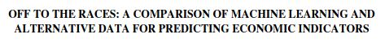
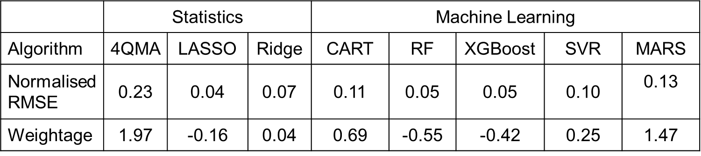
DSA Techniques
Table 1 Model Performance Comparison for Quality Service Survey on RPC
Findings : Tree-based Ensemble models resulted on the best predictions. Such models are random forests and gradient boosting. The reason is because they can learn nonlinear patterns of economic indicators. (Chen et al., 2018)

Slide 11
DSA Techniques
Table 1 Model Performance Comparison for Quality Service Survey on RPC
Findings : LASSO regression also shows good prediction performance. However, its improvement weightage is lesser than RF & XGBoost (Chen et al., 2018)

Slide 12
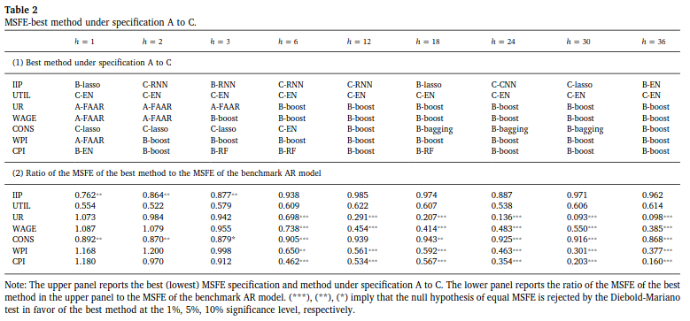
DSA Techniques
Table 2 Model Performance Comparison for Macroeconomic Forecasting
Findings : Ensemble learning based on regression trees (bagging, random forests, and boosting) is the best method due to their adaptability with nonlinear trends of macroeconomic indicators. (Maehashi and Shintani, 2020)

Slide 13
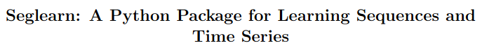
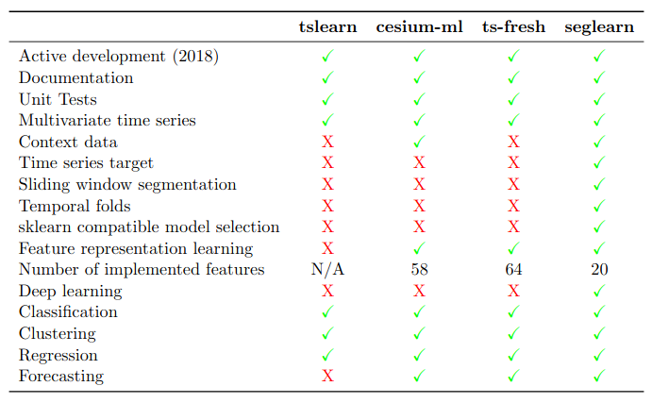
DSA Tools
Table 3 Comparison of features between libraries
Findings : seglearn library has the most feature for time series prediction.
: This library also can incorporate classification, regression, clustering, and forecasting tasks.
: Most importantly, seglearn has sliding window segmentation, and adaptable to sklearn models (Burns and Whyne, 2018).
:

Slide 14
Contribution Table
Objectives | Method used | Contribution
To investigate the suitable machine learning technique for RPC prediction. | Literature Review | Suitable ML models: XGBoost AdaBoost Bagging Random Forest
To develop RPC prediction model using selected machine learning algorithms. | Develop prediction models using the most suitable models | RPC prediction models
To evaluate the performance of RPC prediction models. | Compare among selected ML models Compare statistical techniques with selected ML algorithms | Performance comparison among ML models Performance comparison between statistical with ML

Slide 15
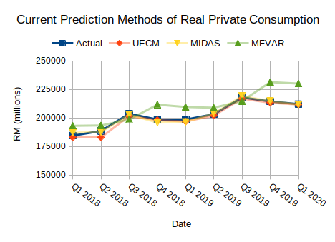
Problem Analysis
Currently, MoF is finding a methodology to optimise RPC predictions in order to predict future values with higher accuracy.
As of now, their best model is MIDAS followed by UECM and lastly MFVAR.
This is indicated by their prediction error (RMSE) with MIDAS having the least while MFVAR having the most error.
Could Machine Learning outperform these?
Figure 3 Current Prediction Methods of RPC

Slide 16
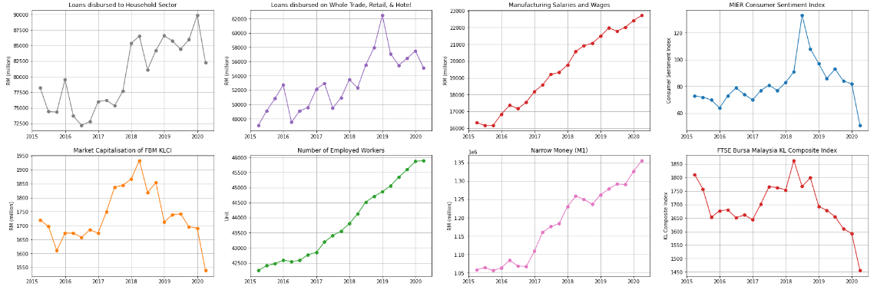
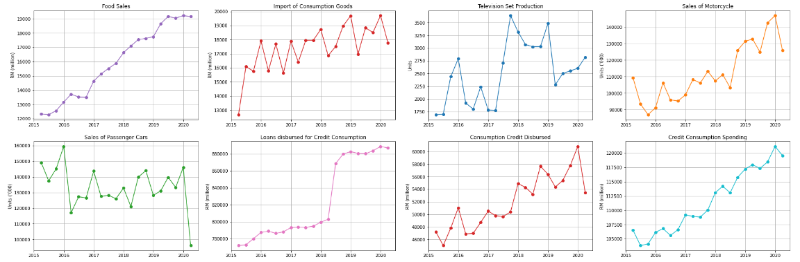
Research Methodology: EDA
Prior to the COVID-19 pandemic (Q1 2020), 13 out of 16 RPC indicators show an increasing trend.
Overall, 11 of the 16 indicators show nonlinear trends except for MSW, NM, FS, EMP, and CC.
During Q1 2020, 9 indicators significantly declined

Slide 17
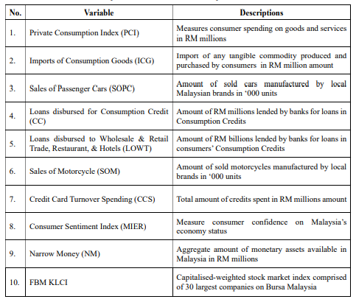
Problem Analysis
No of Attributes
16 Economics Attributes
No of Rows
303 Monthly instances
Time Frame
1995 – 2020
Data Source
Bank Negara Malaysia
Department of Statistics Malaysia

Slide 18
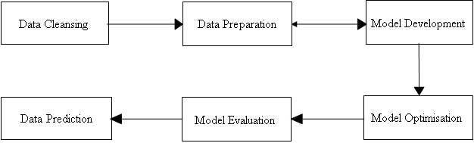

Implementation
Figure 4 Process Flow of RPC prediction implementation

Slide 19
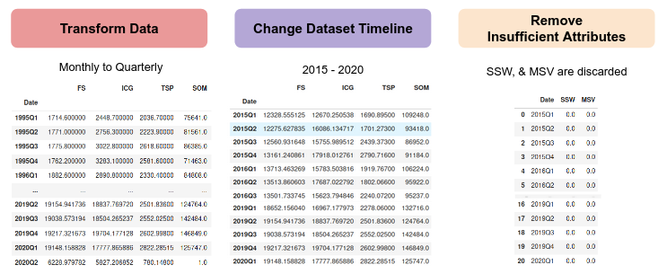
Research Methodology : Data Cleansing
Figure 5 Output of each process in Data Cleansing phase

Slide 20
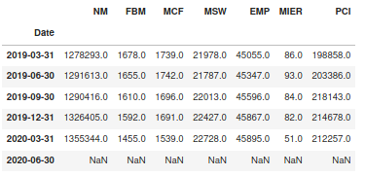
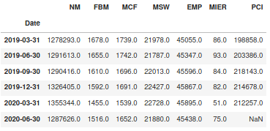
Research Methodology : Data Preparation
Figure 6 Output of RPC indicators before (left) and after (right) Windowing process

Slide 21
Research Methodology : Model Development
Table 5 Model prediction errors (RMSE) during Model Development
Data Splitting Methods | Bagging | Random Forest | AdaBoost | XGBoost
Expanding Window | 7138.13 | 7057.10 | 5982.15 | 5837.29
Sliding Window (window size = 5) | 7036.21 | 6554.78 | 6530.31 | 5693.98
Non-Random Percentage Split | 27585.97 | 24905.06 | 24387.61 | 22622.79
Findings : Data splitting method using sliding window is the best (Vasconcelos, 2017)
: Boosting models predicted better by having lower RMSE (Weng et al., 2018)
: In short, XGBoost with sliding window is the best algorithm for RPC prediction

Slide 22
Research Methodology : Model Optimization
Optimization Method
Data Splitting
Feature Selection
Time-based Cross Validation
Percentage Split
Filtering attributes based on their significance scores

Slide 23
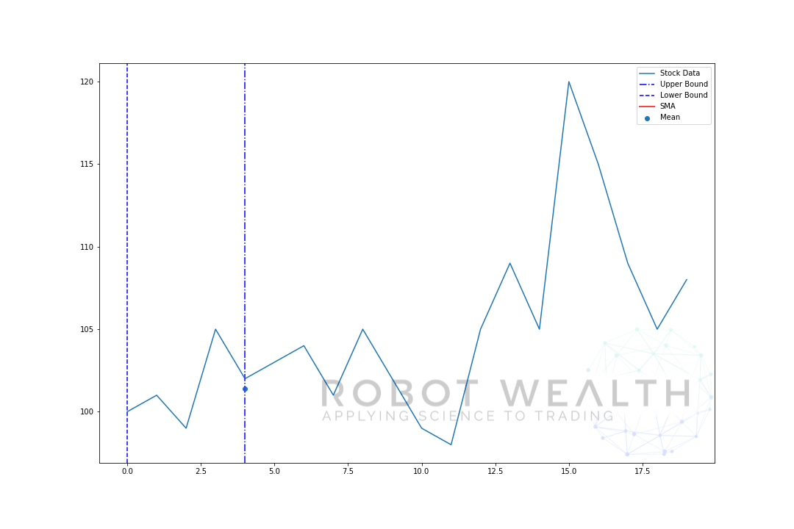
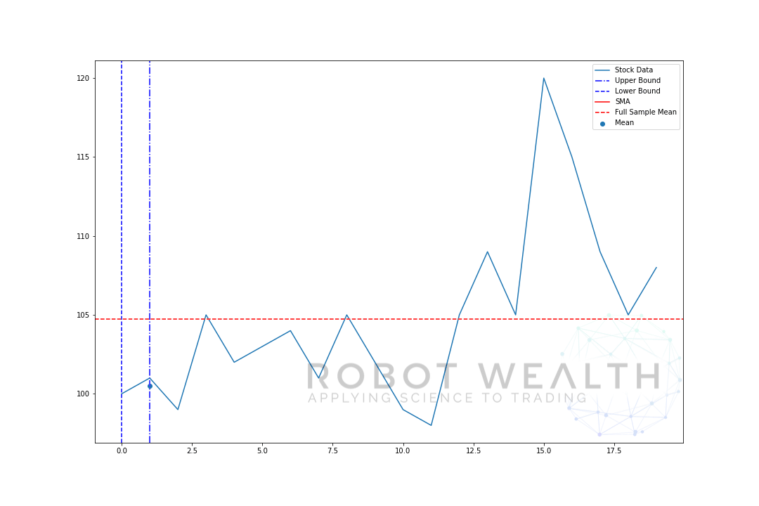
Research Methodology : Model Optimization
1) Data Splitting (Windowing or Time-based cross validation)
Figure 6 Illustration of sliding window (left) and expanding window (right) method
How to optimize?
- Determine the best window size
How to optimize?
- NaN

Slide 24
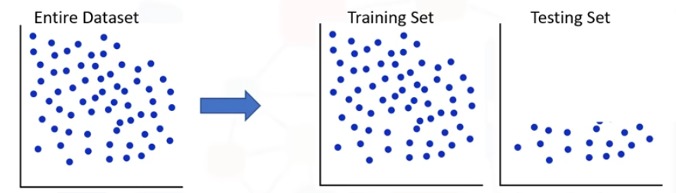
Research Methodology : Model Optimization
1) Data Splitting (Percentage Split)
Figure 7 Illustration of Percentage Split by 80:20
60 : 40
70 : 30
How to optimize?
Determine the best percentage split size
80 : 20
90 : 10

Slide 25
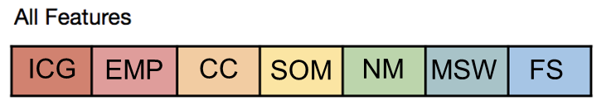
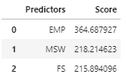
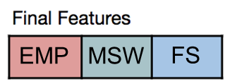
Research Methodology : Model Optimization
2) Feature Selection (SelectKBest)
All Attributes
Feature Selection
Selected Attributes
How to optimize?
Determine best number of significant attributes

Slide 26
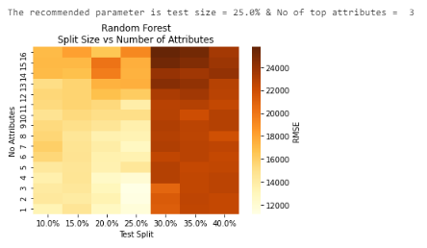
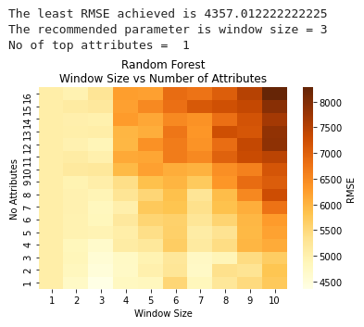
Research Methodology : Model Optimization
Figure 7 Recommended configuration by Random Forest using NRS (left) & sliding window (right)

Slide 27
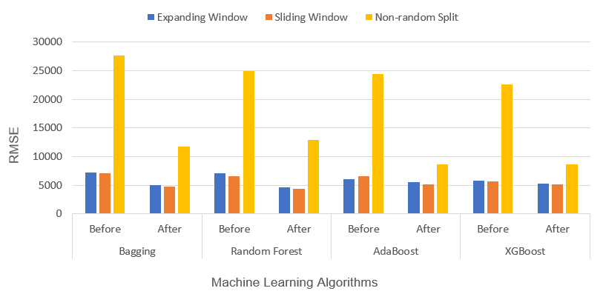
Research Methodology : Model Optimization
All Machine Learning models’ RMSE are reduced
Sliding window produced lowest RMSE for all machine learning algorithms
Non-random split produced the highest RMSE
Random Forest with sliding window produced least RMSE
Figure 9
Comparison of RMSE before and after model optimisation

Slide 28
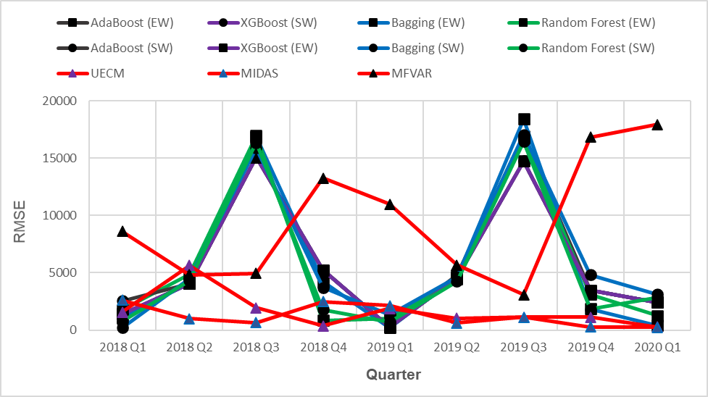
Results and Discussions: Model Evaluation
MIDAS produced the least RMSE compared to others
This shows that MIDAS is the most reliable model for predicting time series of RPC
The third-best model is Random Forest with sliding window
The optimized Random Forest model is not yet at par with the current statistical techniques
Figure 10 Comparison of RMSE between
machine learning algorithm with statistical techniques

Slide 29
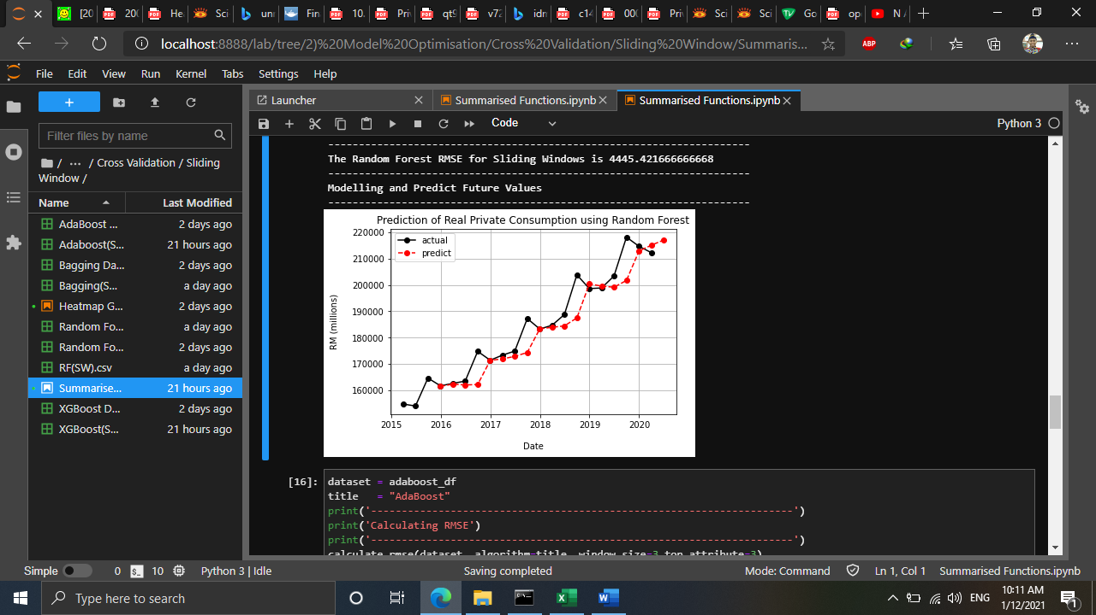
Results and Discussions: Data Prediction
RF shows a good prediction results throughout the time series except for the Q4 of each year
This shows its potential to surpass statistical techniques if it is further optimised.
RF predicted the future value for RPC in the second quarter of 2020 is RM 217055 million
The predicted value is deviated away, due to outlier factor which is the COVID-19 pandemic
Figure 10 Comparison of RMSE between
machine learning algorithm with statistical techniques

Slide 30
Conclusion and Lesson Learned
Table 6 Conclusion Summary
Objectives | Status of Achievement | Findings
To investigate the suitable machine learning technique for RPC prediction. | Achieved | Tree-based ensemble models were the most suitable models
To develop RPC prediction model using the selected machine learning approach. | Achieved | Tree-based ensemble models have been successfully developed and optimised
To evaluate prediction performance of the RPC prediction models. | Achieved | Statistical techniques remain better than ML for RPC prediction

Slide 31
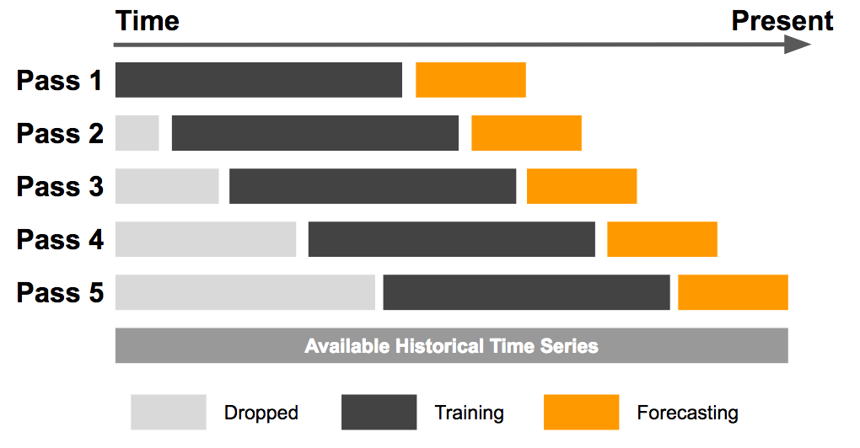

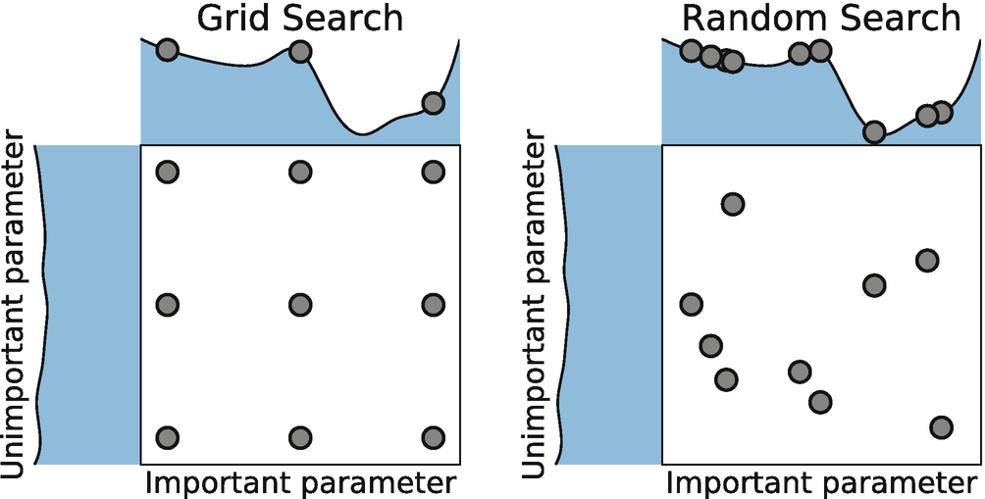
Future Work
Windowing
Data Splitting Methods
Percentage Split
Eg: Train % : Test %
Filter-based
SelectKBest
Model Optimization
Feature Selection
Wrapper-based
Recursive Feature Elimination
Eg: Select top 5 attributes
Embedded
SelectFromModel
Random Search
Hyperparameter Tuning
Grid Search
Eg: kernel: RBF, sigmoid

Slide 32
Conclusion and Lesson Learned
Lesson 1 : Have a basic knowledge of client’s domain
Lesson 3 : Master communication skills to engage with people and clients
Lesson 2 : Possess storytelling skills

Slide 33
Challenges and Solutions
Challenge 1 : Finding literatures comparing statistics with machine learning on economics domain
Challenge 3 : Unexpected outcome of model evaluation
Challenge 2 : Python Coding for Development & Optimization

Slide 34
Thank You

Slide 35
Backup Slides

Slide 36
Related Works: Review on Domain
In particular, RPC is indicated by 18 indicators as published in MoF (2017).
FS
ICG
TSP
SOM
SOPC
CC
CCD
LOWT
CCS
LDH
NM
FBM KLCI
RPC
MCF
MSW
SSW
MSV
MIER
EMP
Source: Ministry of Finance (2017)

Slide 37
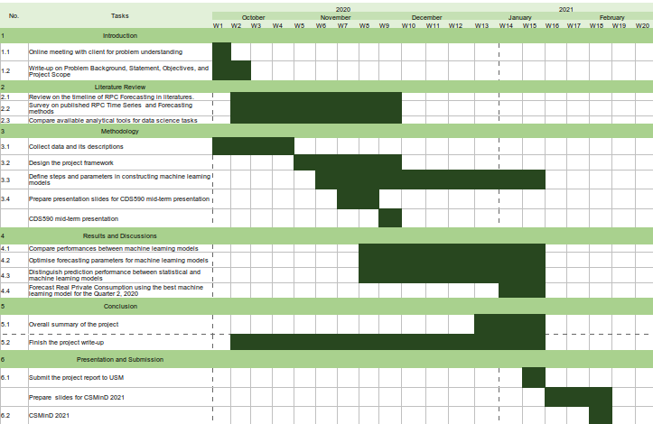
Research Methodology: Activities Plan
From October until early of November, I spent most on the time reviewing articles to select the best algorithms and tools.
From November until December, I utilized mostly on Model Development & Optimization.
Regardless, I managed to finish report as required.
Figure 1 Gantt Chart of Project Consultancy and Practicum

Slide 38

Research Methodology: DS Lifecycle
As a data scientist, my lifecycle has been rolling throughout the data science lifecycle.
I spent most of the time in modeling phase back-and-forth between Feature Engineering and Model Evaluation.
After satisfied with model evaluation, I will propose the machine learning models for the new approach seek by Fiscal and Economics Division, Ministry of Finance, Malaysia.
Figure 2 Data Science Lifecycle Projects

Slide 39
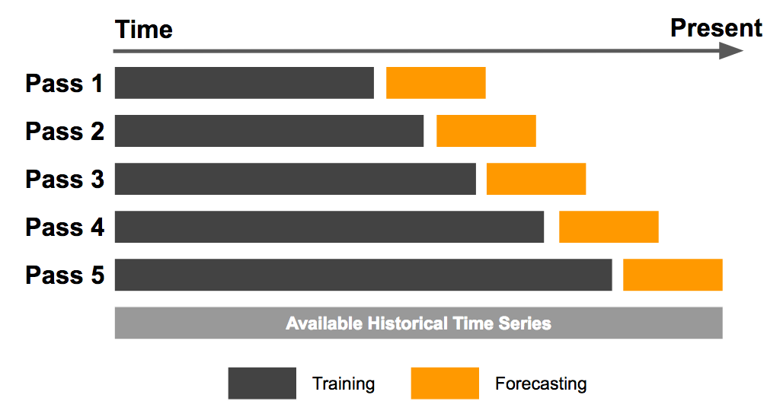
Research Methodology : Data Preparation
Figure 8 Illustration of sliding window (left) and expanding window (right) method

Slide 40
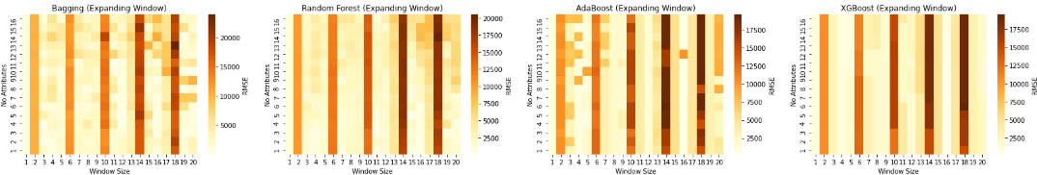
Research Methodology : Model Optimization
Findings : Expanding window shows a significantly higher error for each 4 incremental window sizes

Slide 41
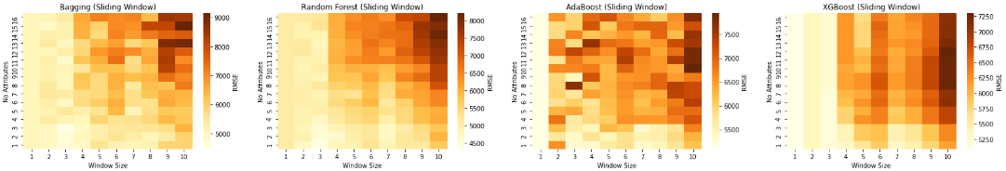
Research Methodology : Model Optimization
Findings : Sliding window displays lower prediction error when small window sizes are applied (window size = 1 until 3)

Slide 42
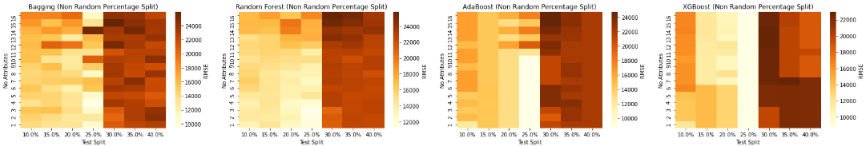
Research Methodology : Model Optimization
Findings : Non-random percentage split performed better when 75:25 data split ratio is used together with a maximum of 5 significant attributes

